Slide 1
Gap analysis source code guide
Andres Mendez, Harold Achicanoy

Slide 2
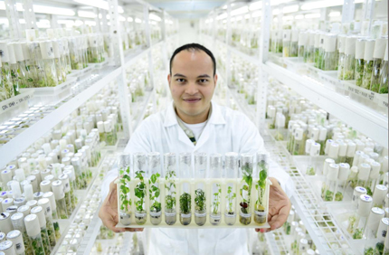
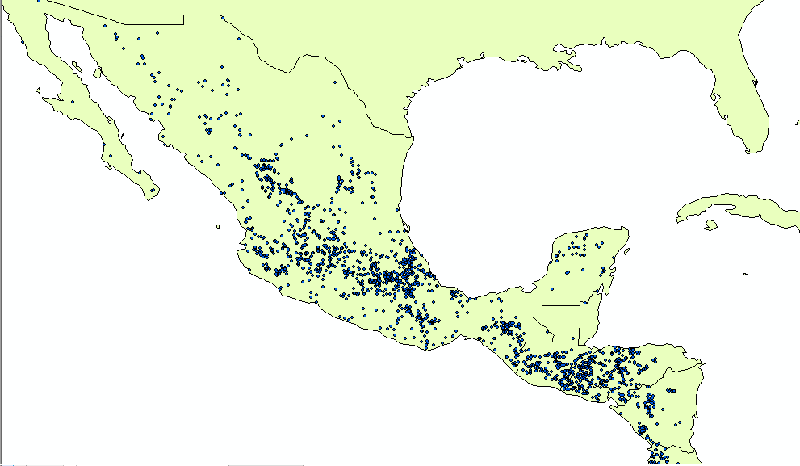
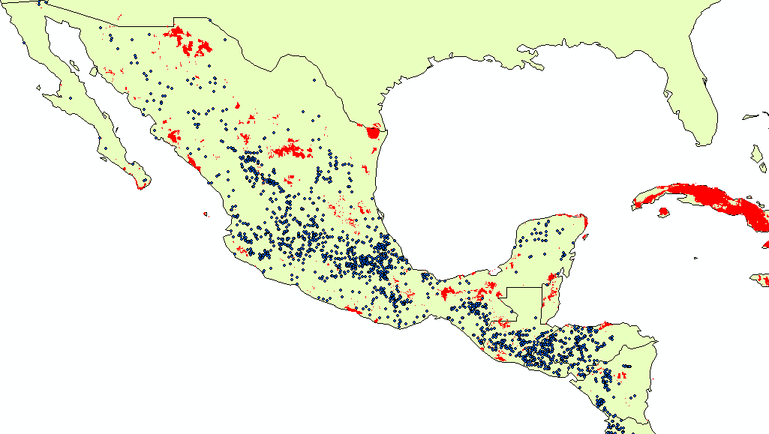

Slide 3
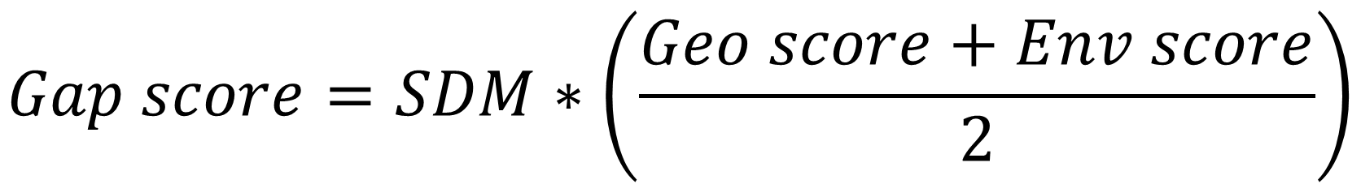
Gap metric
Probability of finding a landrace in the region of interest
$$Gap score=SDM∗\left(\frac{Geo score+Env score}{2}\right)$$
Probability of finding a gap measured by the mean
between the Geographical and Environmental scores,
equally weighted

Slide 4
Previous concepts: input data
 |  | 1 | 1 |  |  | 4 | 5
 |  | 2 | 2 | 3 | 3 | 2 | 2
 |  |  | 3 | 4 | 2 | 3 | 1
 |  | 3 | 5 | 2 | 0
 |  |  | 2 | 1 | 1
Matrix of values with geographical
coordinates associated
Each pixel has associated a resolution
i.e., 5 km
Y: Latitude
X: Longitude

Slide 5
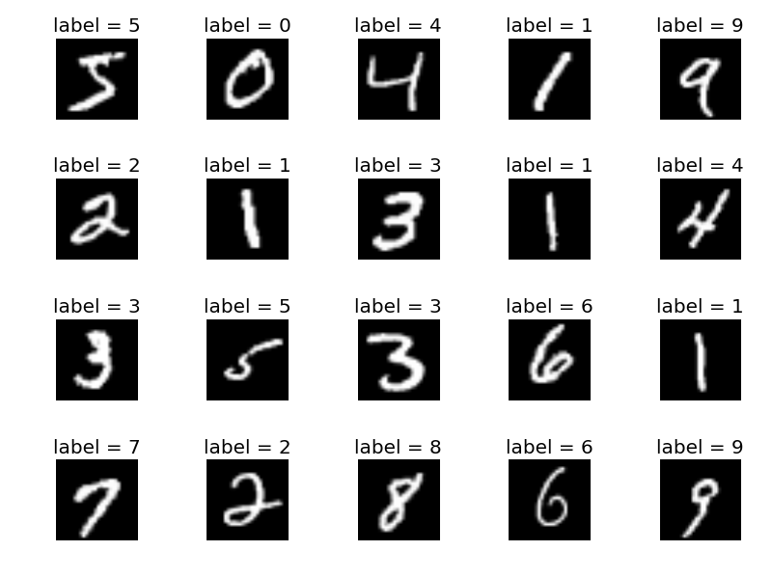
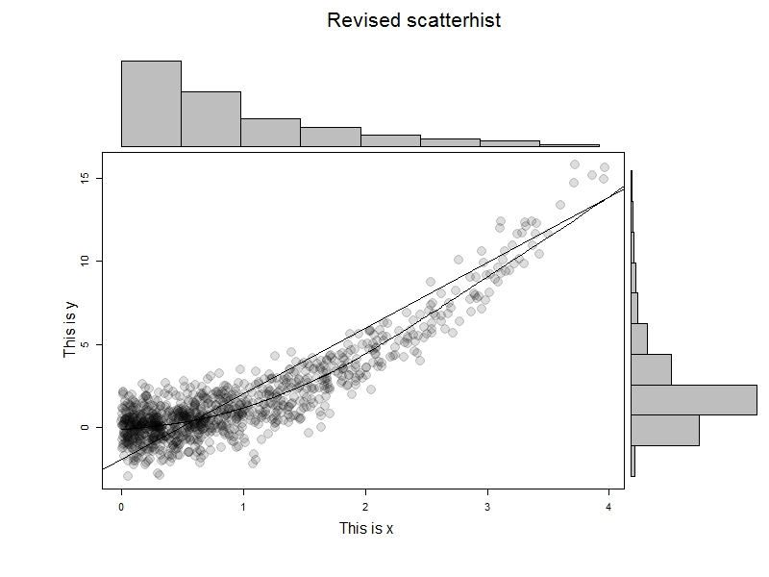
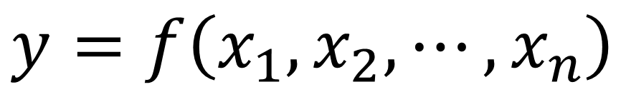
Previous concepts: modeling
$$y=f\left(x_{1},x_{2},⋯,x_{n}\right)$$
Classification
Regression
Explain or predict

Slide 6
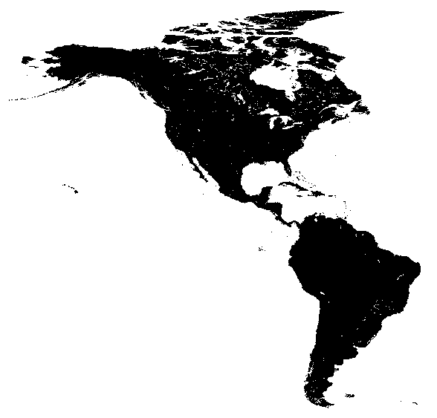
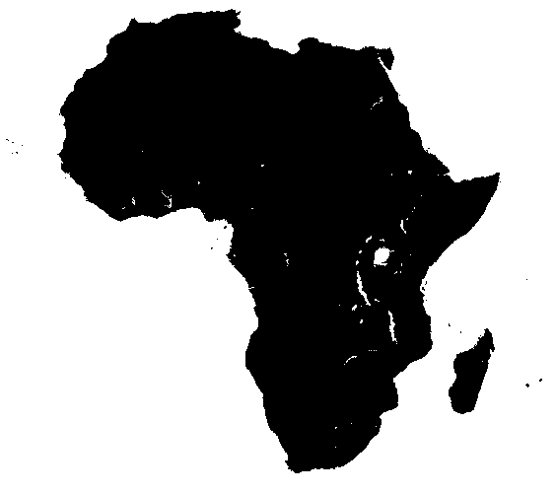
Study regions (maize)

Slide 7
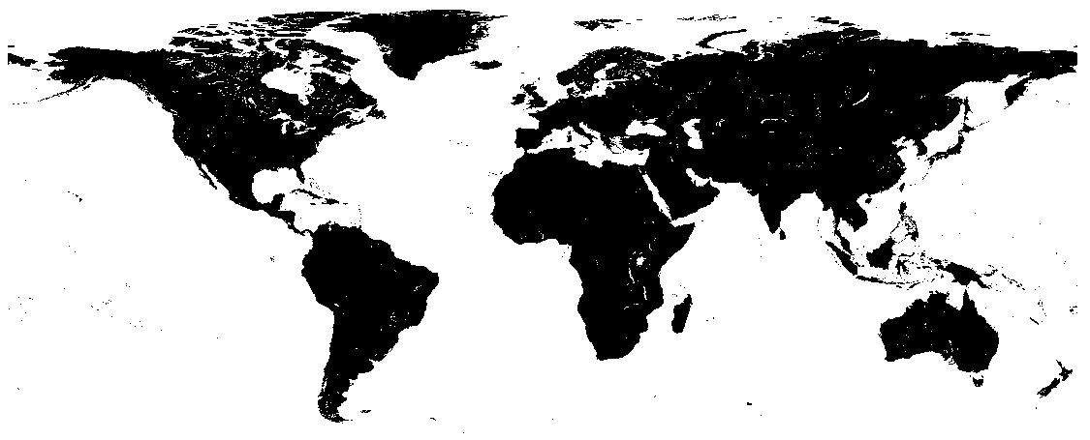
Study regions (wheat)

Slide 8
Requirements
Statistical software R (version > 3.4) https://cran.r-project.org/bin/windows/base/
RStudio https://www.rstudio.com/products/rstudio/download/
GIS software: ArcGIS (licensed software) or QGIS (free software) (https://qgis.org/es/site/forusers/download.html). This software is optional and is used just for visualization purposes
MaxEnt Java application (https://github.com/mrmaxent/Maxent/tree/master/ArchivedReleases/3.3.3a). Optional if you want to use the java version, currently exists a MaxEnt version implemented in R which is more efficient

Slide 9
Data sources (generic rasters)
Climate variables
WorldClim variables: http://worldclim.org/version2
ENVIREM variables: http://envirem.github.io/
Irrigation
Global map of irrigation areas http://www.fao.org/nr/water/aquastat/irrigationmap/index10.stm
Own calculation
Distance to human settlements: it corresponds to the distance of every site to the closest place where an historical civilization has been reported. It is a proxy of markets access.
Distance to rivers: it corresponds to the distance of every site to the closest place where an historical civilization has been reported. It is a proxy of markets access.

Slide 10
Data sources (crop-specific rasters)
Physical area, production and yield per crop: http://mapspam.info/
Distance to Genepool 1 of the crop: it represents the distance of every site to the closest place where an accession exists which come from Genepool 1 of the crop. It is a proxy of closeness to the ancestral crop origin.

Slide 11
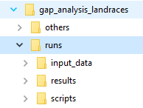
Folder structure
All of the necessary inputs. i.e. environmental variables, passport data, etc…
All results are stored in this folder
All the R scripts containing the functions to process the data and produce results. These scripts are up to date in GitHub repository where it could be downloaded (https://github.com/CIAT-DAPA/gap_analysis_landraces)

Slide 12
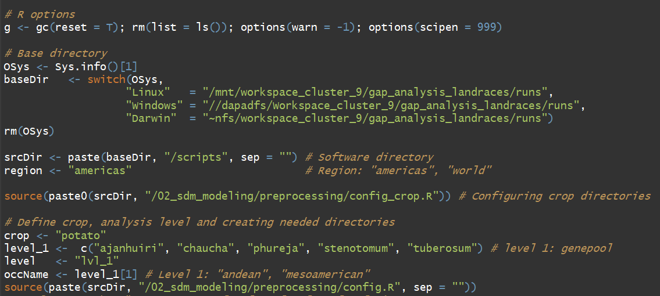
Master code
baseDir
Change it according to the folder in which you stored all files (i.e. C:/Users/Documents/runs)
region
Change it according the region of study
Crop
Name of the crop
Level_1
Very important field, based on the major crop structure, in this field you have to define the names of each variety, race, etc… taking into account that these names ought to be the same that appears in the passport data(upper and lower cases)
occName
The script can only process one specie per time, so in this field you have to specify which specie you want to process

Slide 13
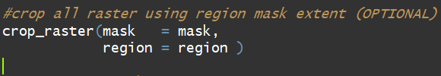
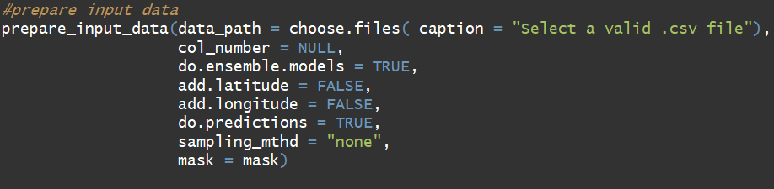
This function allows you to prepare all the rasters files depending of the study regions defined before. This function crops all rasters at the same extent and save them in their specifics folders.(THIS FUNCTIONS ONLY HAVE TO BE RUN ONLY ONCE)
This function prepares the passport data and only needs three columns, also it fit the ensemble model and make predictions:
The first one is the column with the race, species names (response variable)
Second is the latitude
Third is the longitude
Optional
Parameters:
col_number: column number of response variable
do.ensemble.models: whether fit the ensemble model
add.latitude and add.longitude: whether use lon or lat as explanatory variables
do.predictions: whether the ensemble model has to predict NA occurrences

Slide 14
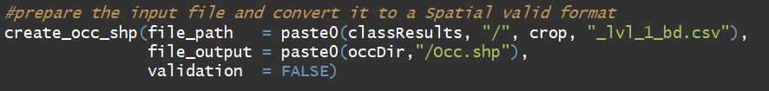
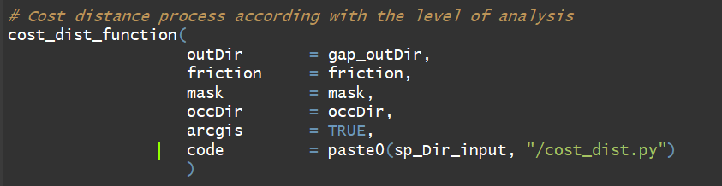
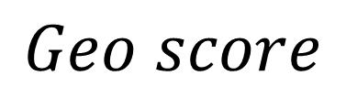
Function to convert the occurrence coordinates file to a shape file(occ.shp) format, filtered by the specie that is being modelled. The file is stored in the folder …/input_data/by_crop/crop/region/lvl_1/specie_i/occurences/Occ.shp
$$Geo score$$
Function to calculate the cost distance raster. This function implement two methods to calculate this input: using ArcGIS or using R. The first method is pretty much faster but you have to get the license for use ArcGIS, otherwise you have to use R

Slide 15
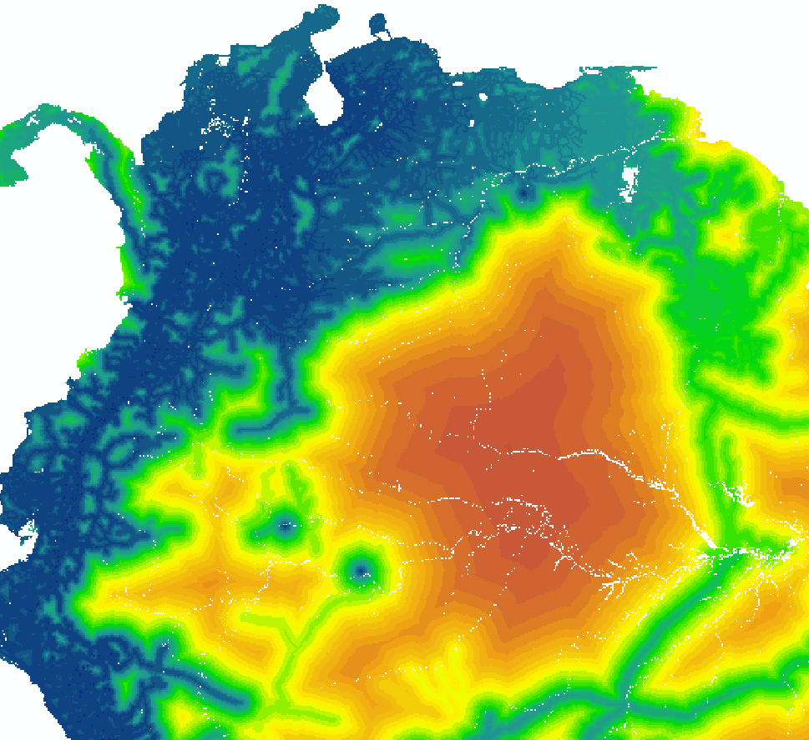
Cost distance map

Slide 16
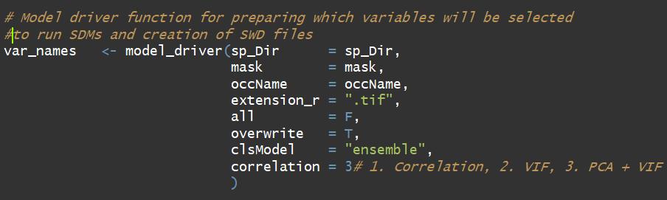
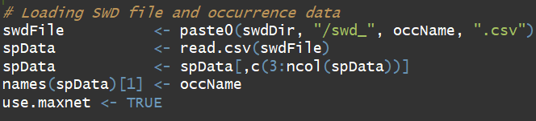
Function to create the necessary files to perform the Spatial Distribution Modelling using the MaxEnt model, this function does:
Create the background files (pseudo-absences)
Perform a variable selection in order to remove correlated variables
This lines of code, calls the background file created by the model_driver function and configure it to be processed.
The parameter use.maxnet control the type of model used to model the spatial distribution of the specie:
use.maxnet = TRUE: uses the MaxEnt model implemented in R.
use.maxnet = FALSE: uses the MaxEnt model implemented in Java.

Slide 17
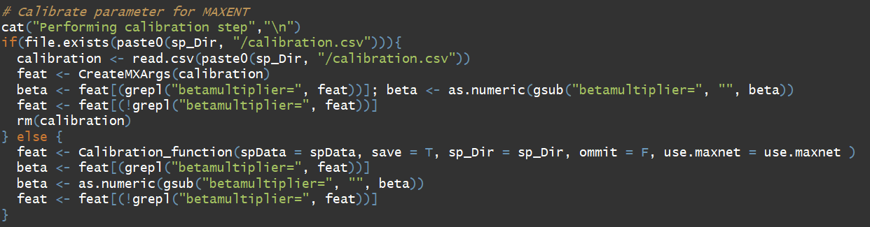
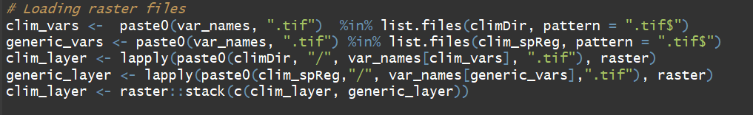
In these lines a calibration step is performed in order to find out which are the best parameter for the MaxEnt model
These code lines call all the input rasters and stack them into a single variable called clim_layer, this variable will be important to fit the models

Slide 18
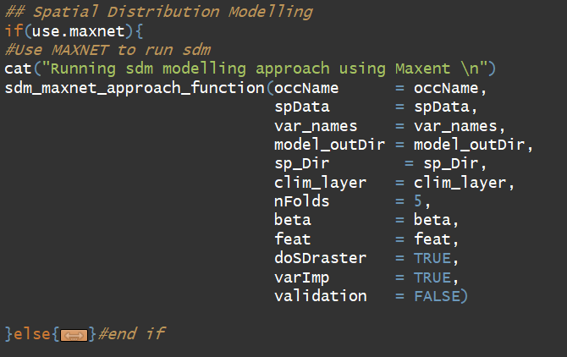
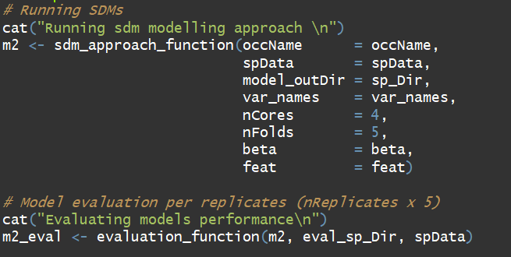
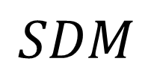
If use.maxnet is setting to TRUE, then this functions is run, it’s pretty much faster. This function carry out an complete evaluation of the models through Cross validation, The results are stored in a single RDS file in the path: /runs/results/crop/lvl_1/specie_i/region/sdm.rds.
The output is a raster scaled from 0 to 1 indicating the niche suitability, it’s stored in the folder: /runs/results/crop/lvl_1/specie_i/region/prj_models
$$SDM$$
If use.maxnet is setting to FALSE, then the Java application of MaxEnt is called. This app is slower and implies to have installed the correct version of Java, an additional R package and the Java application have to be stored in a specific folder, otherwise a error will be thrown.
The output is a raster scaled from 0 to 1 indicating the niche suitability, it’s stored in the folder: /runs/results/crop/lvl_1/specie_i/region/prj_models

Slide 19
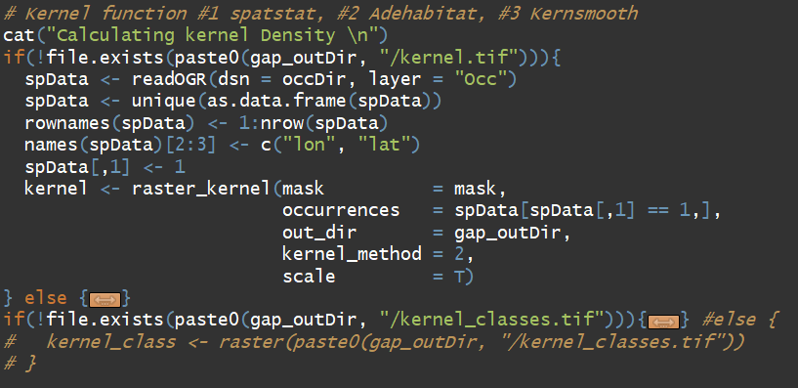
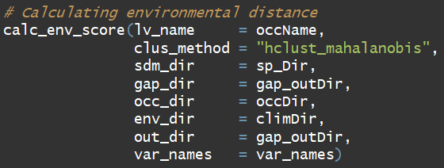
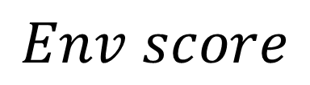
This function calculate the kernel density raster using the passport data. There exists three methods to calculate the kernel density. For default we are using the kernel_method number 2 (is may be the more accurate and faster).
The output is a raster file stored in:
/runs/results/crop/lvl_1/specie_i/region/gap_methods/kernel.tif
$$Env score$$
This function calculates one of the most important inputs to calculate the gap scores. Recommendation: don’t change the default parameters.
The output is a raster file stored in:
/runs/results/crop/lvl_1/specie_i/region/gap_methods/env_score_hclust_mahalanobis.tif

Slide 20
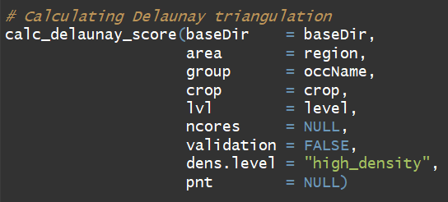
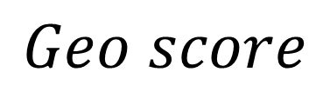
Single laptop vs server
Parallelize?
SI
n.cores > 10
NO
n.cores = NULL
$$Geo score$$
This function creates one of the most important inputs called Delaunay triangulation.
The output is a raster file stored in:
/runs/results/crop/lvl_1/specie_i/region/gap_methods/delaunay.tif

Slide 21
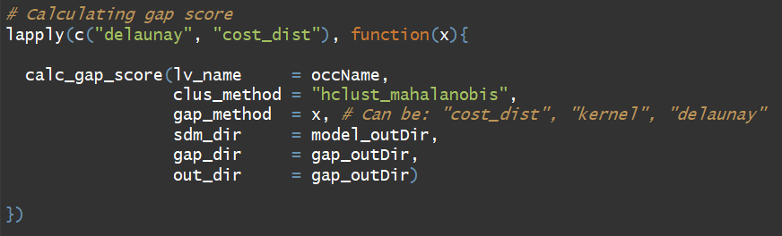
Very important step, here all the gap scores are calculated based on the formula previously specified
The gap score cost distance is stored in: /runs/results/crop/lvl_1/specie_i/region/gap_methods/gap_score_cost_dist.tif
The gap score Delaunay triangulation is stored in: /runs/results/crop/lvl_1/specie_i/region/gap_methods/gap_score_delaunay.tif
Up to this moment both rasters are in a continuous scale that difficult the identification of gap areas

Slide 22
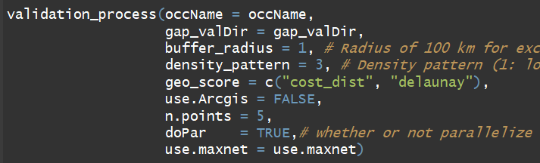
Single laptop vs server
Parallelize?
SI
n.cores > 10
NO
n.cores = NULL
This function creates all the necessary files to perform the validation step, this function needs to run all the function above 5 times, this will take too much time but we can reduce this time if we have access to remote servers or a computer with multiple cores and large RAM memory. Then, if you have this kind of tools then set doPar parameter to TRUE. If you only have a laptop with limited resources then we recommend set doPar to FALSE

Slide 23
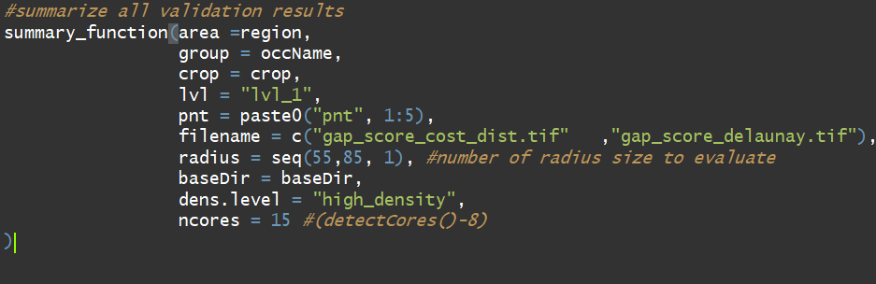
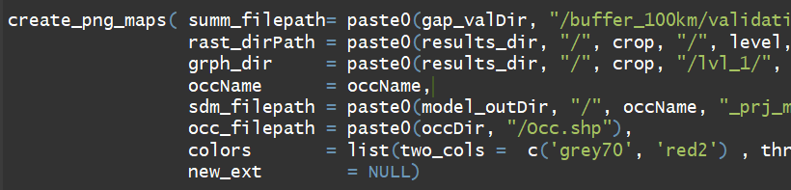
This function uses the files created before by the function validation_process and calculate some important metrics from the gap score models aiming to define a threshold, that can help us to identify potential areas of gap.
This function executes too much operations and also can take much time, that’s why it can be parallelized thorugh n.cores parameter, just in case that the requirements of the computer allow it.

